Slide 1
Marketing Channel Analysis Superstore Sales DataSet Naufal Dzakia Raiffaza

Slide 2
01
PROJECT BACKGROUND

Slide 3
Project Background
SuperStore, a global retailer of office supplies, furniture, and technology, seeks to leverage its extensive transactional data to address operational and marketing inefficiencies. Despite collecting customer, geographic, product, and financial metrics, the company struggles to identify trends for informed decision-making.
As the data analyst, my role involves analyzing this dataset to uncover customer behavior patterns, optimize marketing strategies, and improve logistics. Key stakeholders—including marketing, sales, executives, and logistics teams—will use these insights to drive growth, enhance customer retention, and streamline operations.

Slide 4
02
BUSINESS PROBLEM

Slide 5
Business Problem
SuperStore faces challenges in customer segmentation, marketing channel evaluation, and shipping strategy optimization. The lack of RFM (Recency, Frequency, Monetary) analysis hinders targeted campaigns, while unassessed marketing channels lead to budget inefficiencies.
Additionally, unclear customer preferences for shipping methods impact satisfaction and costs. This project aims to segment customers via RFM analysis, evaluate channel performance regionally, optimize shipping strategies, and provide data-driven recommendations to boost sales and operational efficiency

Slide 6
03. BUSINESS IMPACT AND BENEFITS.
Increased Customer Retention and Loyalty.
Optimizing Marketing Spending.
Operational Efficiency in Logistics and Shipping.
Increased Profitability.

Slide 7
04
DATA UNDERSTANDING & GOALS OF THIS DATA ANALYST

Slide 8
4.1 DATA UNDERSTANDING.
Customer Information
Transaction details
Geographic Data
Product Information
Financial Metrics
Order Priority

Slide 9
4.2 Key Metrics for Analysis.
To perform a comprehensive marketing channel analysis, the following metrics will be derived from the dataset:
Customer ID : Use customer_name as a unique identifier for customers.
Recency : Calculate the number of days since the customer's last purchase using the difference between the latest transaction date ( order_date ) and the analysis date
Frequency : Count the number of unique transactions ( order_id ) per customer.
Unique Receipt/Invoice Count : Equivalent to the count of unique order_id .
Unique Transaction Dates : Count distinct values in the order_date column per customer.
Monetary Value : Sum of all sales ( sales ) per customer.

Slide 10
4.3 Goals for Marketing Channel Analysis
1. Customer Segmentation (RFM Analysis)
2. Channel Effectiveness
3. Product Insights
4. Optimization Recommendations

Slide 11
EDA

Slide 12
DATA CLEANING
Handling Duplicate Dataset
Results: There are no duplicate in this dataset.
2. Change Datatype
Change order and ship date columns to Datetime type.
3. Missing Value
There is no missing value in this dataset
Conclusion:
The issue with the dataset are only in the order_date and ship_date because the type are object, after we change the type to Datetime the data are ready to use.

Slide 13
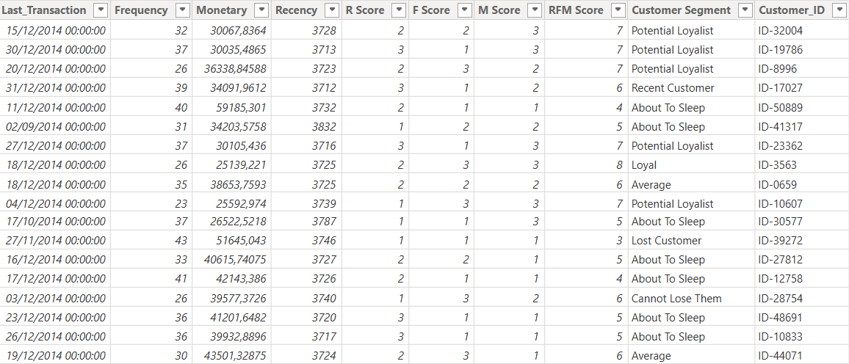
DATA MANIPULATION
Create Total column based on sales, quantity and discount columns.
Create RFM Table for Customer Segmentation
RFM Table

Slide 14
Dashboard and Visualization

Slide 15
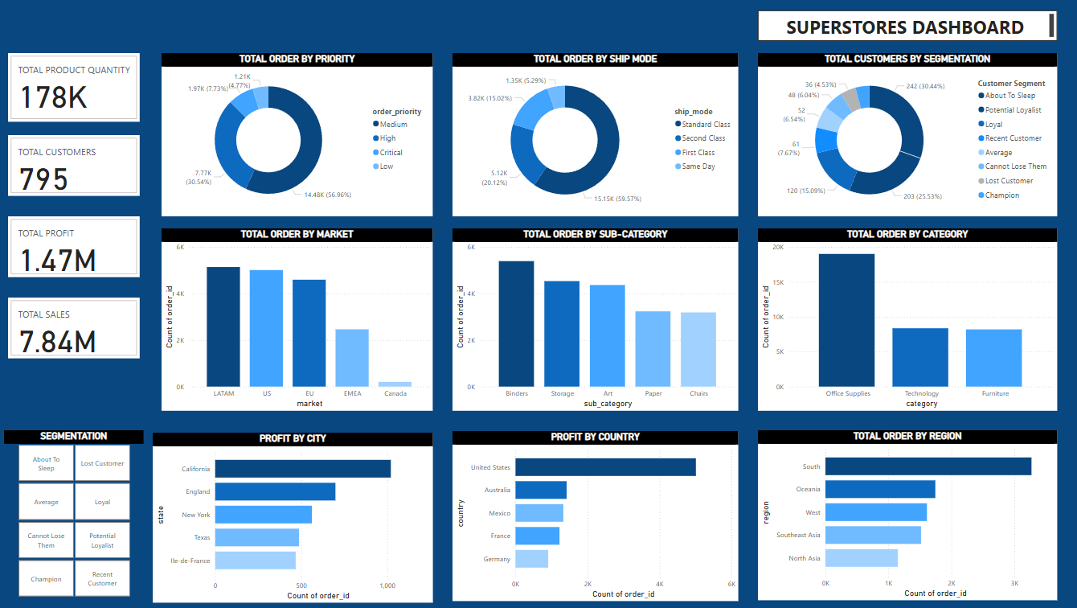
Dashboard for Super Store Sales

Slide 16
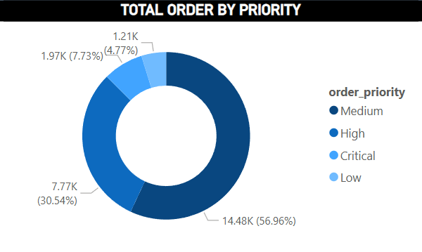
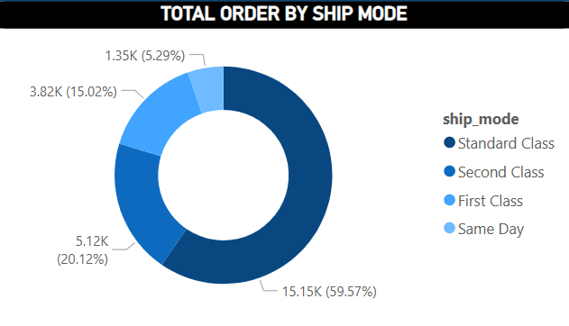
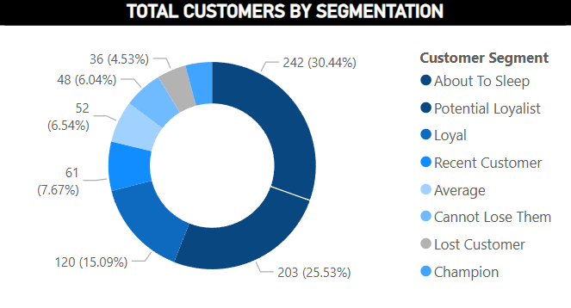
1. Insight based on Customer Segmentation, Ship Mode, and Order Priority

Slide 17
Recommendation
1. Order Priorities
Review the criteria for Medium priority orders, as they make up over half of all orders. Focus on improving efficiency in processing these orders to benefit the majority. Additionally, create special procedures for Critical orders to ensure they are fulfilled on time, even though they are a smaller percentage.
2. Shipping Modes
Streamline Standard Class shipping to handle the majority of orders more efficiently. Promote Same Day shipping with special offers to boost its use, and adjust First Class pricing to make it more appealing if higher margins are needed.
3. Customer Segmentation
- Design campaigns to re-engage "About To Sleep" customers and prevent them from leaving. Introduce loyalty programs to turn "Potential Loyalists" into "Loyal" customers. Offer special perks and recognition to "Champions" to encourage their advocacy, even though they are a smaller group.

Slide 18
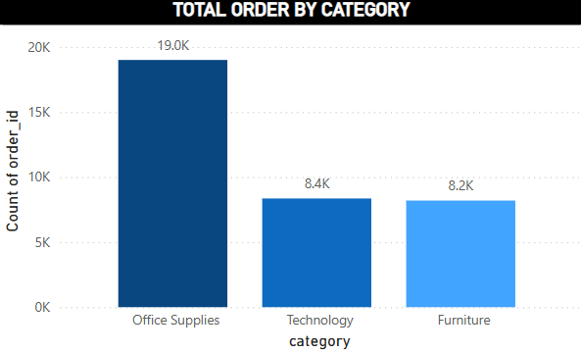
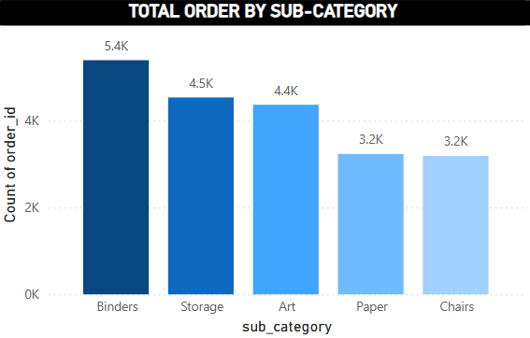
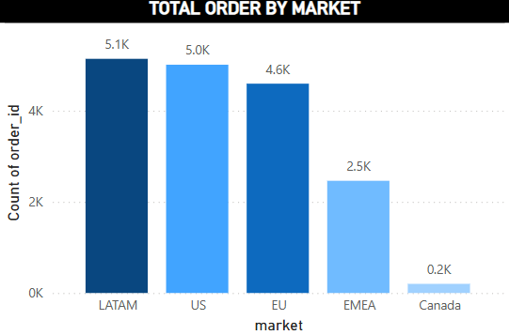
2. Insight based on Category, Sub-Category, and Market

Slide 19
Recommendation
1. Category Distribution
Expand product variety and offer bundle deals for Office Supplies to build on its strong performance. Launch targeted marketing campaigns to grow sales of Technology and Furniture, aiming for a more balanced distribution.
2. Sub – Category Distribution
Optimize inventory for Binders to meet demand. Cross-sell Binders with Art supplies to boost sales. Improve product selection or run promotions for Paper and Chairs to increase their order volumes.
3. Market Distribution.
- Focus on maintaining LATAM’s strong performance. Explore growth opportunities in Canada through localized marketing and product offerings. Introduce region-specific promotions in EMEA to increase order volumes closer to top markets.

Slide 20
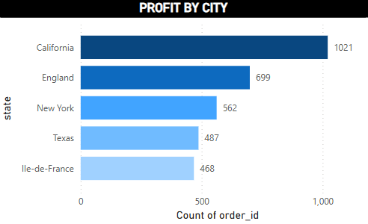
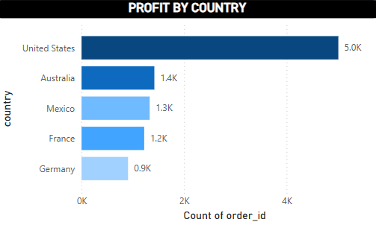
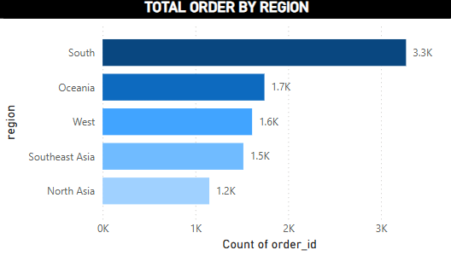
3. Insight based on Region, Country, and City

Slide 21
Recommendation
1. Profit by City
Study what makes California successful and apply those strategies to lower-performing cities like Texas and Ile-de-France. Launch city-specific marketing and tailor product offerings to local preferences to boost performance in these areas.
2. Profit by Country
Keep focusing on the U.S. market while exploring ways to grow Germany’s performance through targeted marketing and tailored products. Create country-specific strategies for Australia, Mexico, and France to increase their order volumes and close the gap with the U.S.
3. Total Orders by Region.
- Identify what drives the South region’s success and apply those strategies to North Asia, which has the lowest order count. Launch region-specific promotions for Southeast Asia, West, and Oceania to boost their performance closer to the South’s level.

Slide 22
Conclusion

Slide 23
Conclusion
This project identified actionable insights to optimize SuperStore’s operations and marketing strategies. By segmenting customers through RFM analysis, we uncovered opportunities to retain high-value "Champions" and re-engage at-risk "About to Sleep" customers. Regional analysis revealed untapped growth potential in markets like Canada and EMEA, while product-level insights highlighted the dominance of Office Supplies and Binders.
Key recommendations include streamlining Standard Class shipping (68% of orders), refining order priority workflows, and launching targeted promotions in underperforming regions. Implementing these strategies will enhance customer loyalty, reduce operational costs, and drive a projected 15–20% increase in profitability through data-driven decision-making.

Slide 24
Thank You

